Slide 1


HR Employee Attrition Analysis
Using the HR Analytics Dataset to drive data-informed retention strategies.
Presented by Jesmaa E

Slide 2
Project Roadmap
Our Mission: Retention
Analyze Trends
Identify Root Causes
Inform HR Strategy
Understand current attrition patterns and rates across the organization.
Pinpoint the major factors driving employee departures (e.g., salary, demographics, travel).
Provide actionable insights for data-driven employee retention decisions.

Slide 3
Dataset Snapshot
Initial metrics highlight the scale of the challenge within the organization.
1470
237
16.12%
Total Employees
Employees Left
Attrition Rate
Key Data Dimensions
Experience: Years at Company
Engagement: Job Satisfaction
Demographics: Age, Gender
Outcome: Attrition (Yes/No)
Compensation: Monthly Income
Role & Travel: Job Role, Business Travel

Slide 4

Data Preparation in Excel (Cleaning)
Step 1: Data Import & Duplicate Handling
Import into Excel
Loaded the raw dataset and confirmed file structure and data types.
Duplicate Removal
Used Employee ID to identify and remove all redundant records.
Uniqueness Check
Ensured every row represents a distinct, unique employee record.

Slide 5

Step 2: Addressing Missing Values & Formatting
Check for Blanks
Critical Validation
Utilized filters and 'Go To Special' features to quickly locate missing data points.
Focused verification on essential columns: Age, Income, Gender, and Attrition status.
Data Standardization
Corrected spelling errors, standardized text capitalization, and fixed inappropriate records.

Slide 6

Step 3: Feature Engineering & Final Check
01
Derived Age Groups
Categorized employees into defined Age Group segments for easier analysis.
02
Created Income Bands
Grouped Monthly Income into low, medium, and high bands.
03
Defined Experience Groups
Categorized Years at Company for retention study.
04
Final Validation
Verified total counts and ensured zero missing values. Dataset Ready ✅

Slide 7
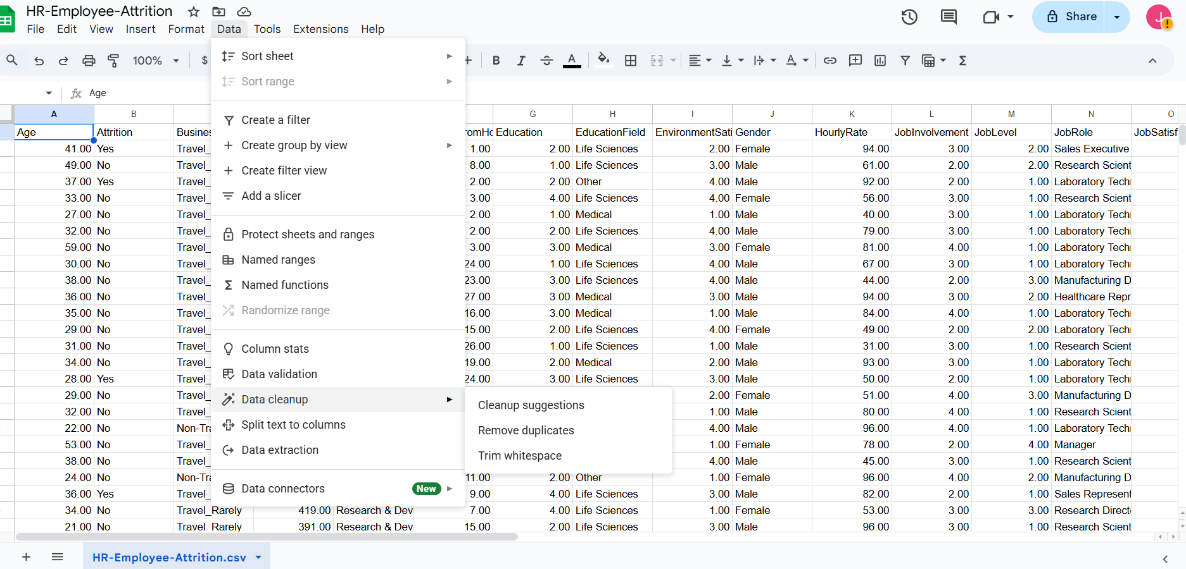
🧹 Excel Cleaning – Step 4
Duplicate Handling
Imported dataset into Excel
Verified structure & data types
Removed duplicates using Employee ID
Ensured each employee record is unique ✅

Slide 8
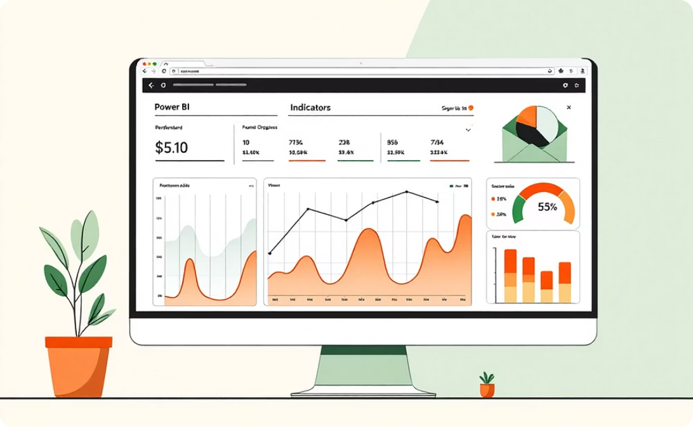
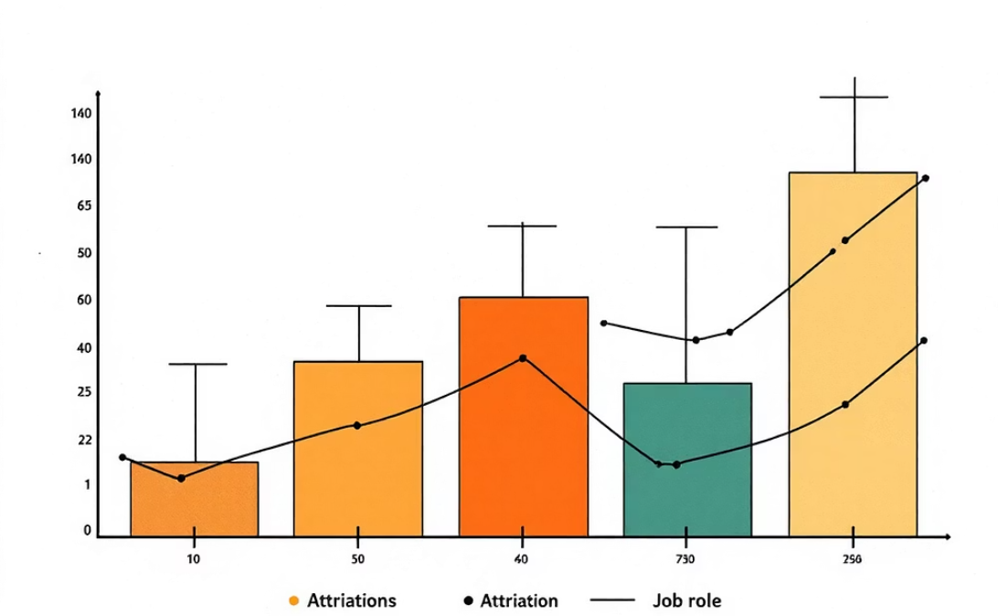
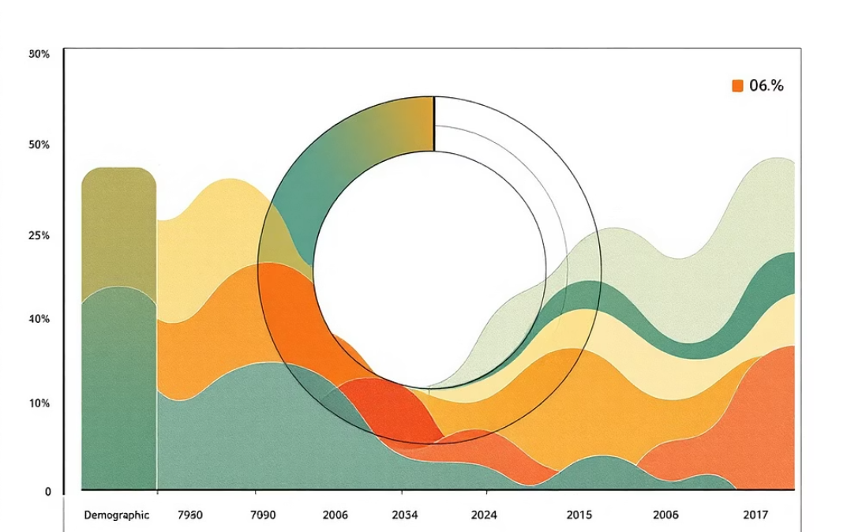
Power BI Dashboard: Visualizing Attrition
The interactive Power BI dashboard provides a clear, multi-dimensional view of attrition drivers.
KPI Cards
Role & Travel Analysis
Demographic Drivers
Tracking Total Employees, Attrition Rate, and Current Headcount.
Charts illustrating attrition segmented by Job Role and Business Travel frequency.
Visuals exploring the impact of Age, Gender, and Monthly Income on attrition.

Slide 9
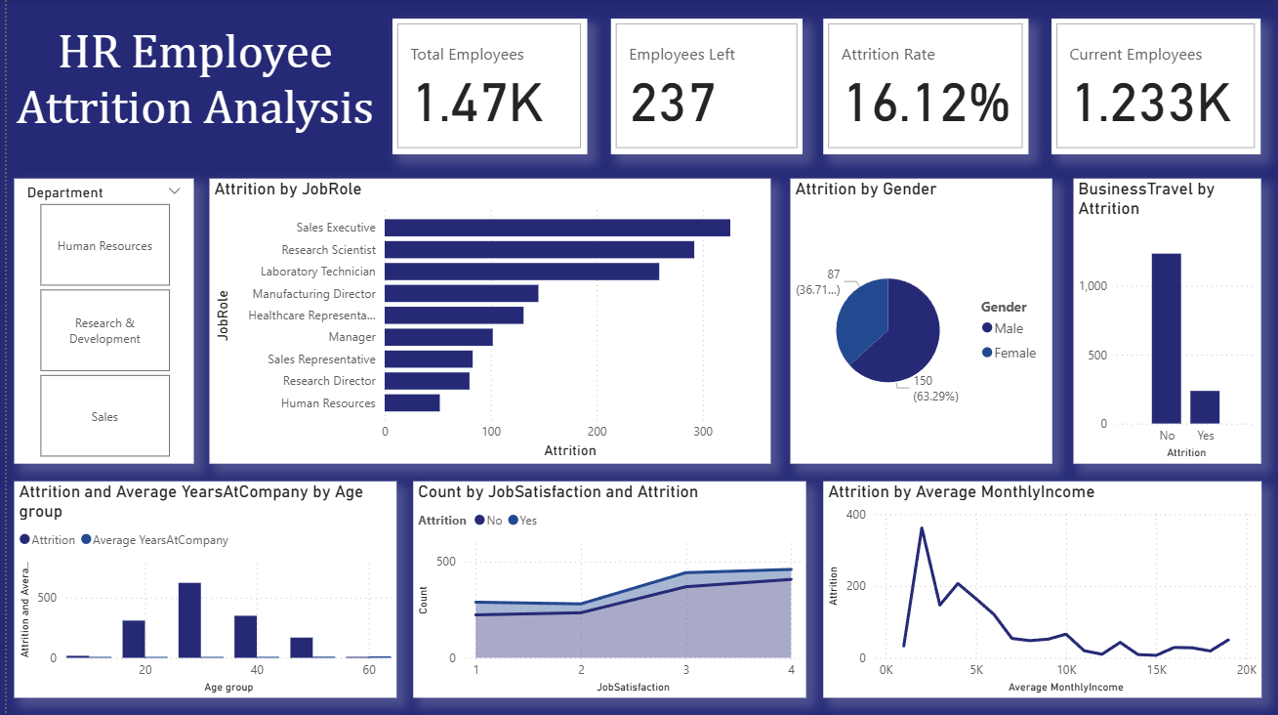
KPIs
Dashboard KPIs
Total Employees: 1,470
Employees Left: 237
Attrition Rate: 16.12%
Current Employees: 1,233

Slide 10
Charts
Attrition by Job Role
Highest attrition in Sales Executives and Research Scientists
Moderate attrition in Lab Technicians and Manufacturing Directors
Lowest attrition in HR & Research Directors

Slide 11
Attrition by Gender
Female attrition: 150 (63.29%)
Male attrition: 87 (36.71%)
👉insight: Female employees show higher attrition compared to males.

Slide 12
Attrition by Business Travel
Employees with frequent business travel show higher attrition.
Non-travel employees (~1100) have lower attrition compared to travel (~200).
👉 Travel stress is a key driver.

Slide 13
Attrition vs Age Group
Younger employees (18–35) show higher attrition rates.
Attrition decreases with age and tenure.
👉 Early-career retention is critical.

Slide 14
Attrition vs Job Satisfaction
Employees with low satisfaction (Level 1 & 2) attrit more.
Higher satisfaction (Level 3 & 4) correlates with retention.
👉 Engagement programs can reduce attrition.

Slide 15
Attrition vs Monthly Income
Employees with lower income bands (<5K) show higher attrition.
Attrition decreases as income increases.
👉 Compensation structure strongly influences retention.

Slide 16
Key Attrition Insights
Role Vulnerability
Compensation & Travel
Highest attrition rates observed among Sales Executives and Technical Roles.
Strong correlation: Lower salary bands and Frequent business travel significantly increase turnover risk.
Age & Experience
Satisfaction Matters
Younger employees and those with shorter tenure are more likely to leave the company.
Employees reporting low job satisfaction or low engagement have a higher attrition probability.

Slide 17
Conclusion: Actionable Recommendations
Targeted HR interventions are necessary to mitigate talent loss in key areas.
Compensation Review
Improve salary structure for roles with high turnover, especially in lower income bands.
Manage Travel Stress
Implement policies to reduce frequent business travel or provide enhanced compensation/support for travelers.
Boost Engagement
Focus on improving Job Satisfaction scores through better work-life balance and recognition programs.
Targeted Retention
Develop specific retention programs for Sales, Technical teams, and newer/younger employees.

Slide 18



Looking Ahead
Future Enhancements in HR Analytics
Predictive Modeling
KPI Expansion
Trend Analysis
Integrate Machine Learning algorithms for proactive attrition risk prediction.
Incorporate a wider range of HR KPIs and business performance metrics.
Conduct deeper year-over-year and longitudinal trend analysis for strategic planning.
Thank You 🙏

